Slide 1

CS 295: Modern Systems GPU Computing Introduction
Sang-Woo Jun
Spring 2019

Slide 2
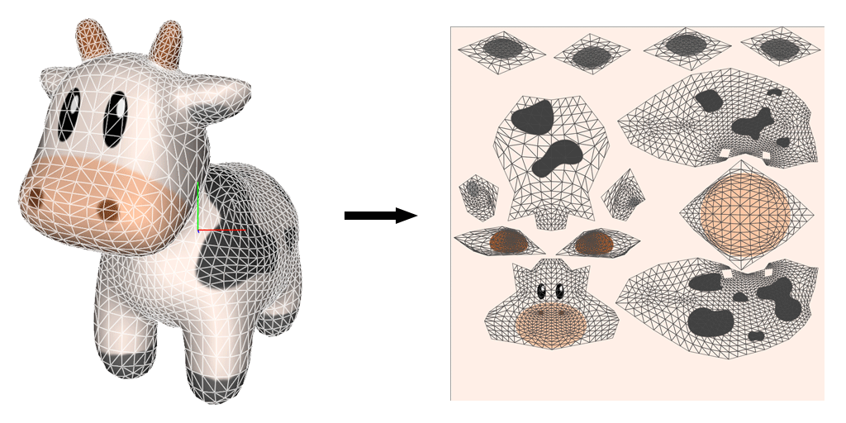
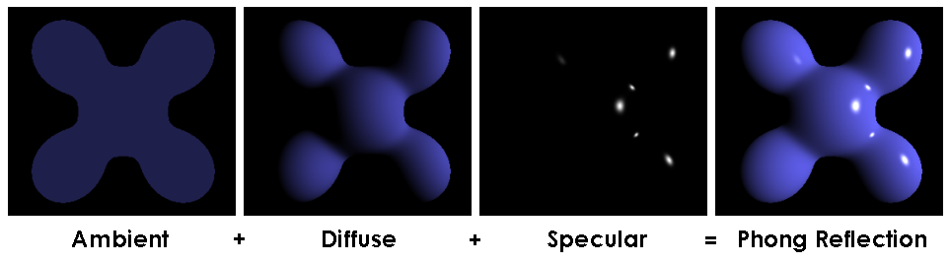
Graphic Processing – Some History
1990s: Real-time 3D rendering for video games were becoming common
Doom, Quake, Descent, … (Nostalgia!)
3D graphics processing is immensely computation-intensive
Texture mapping
Shading
Warren Moore, “Textures and Samplers in Metal,” Metal by Example, 2014
Gray Olsen, “CSE 470 Assignment 3 Part 2 - Gourad/Phong Shading,” grayolsen.com, 2018

Slide 3
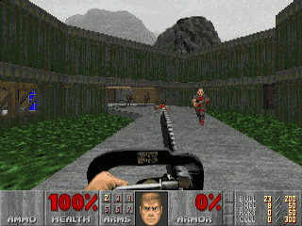
Graphic Processing – Some History
Before 3D accelerators (GPUs) were common
CPUs had to do all graphics computation, while maintaining framerate!
Many tricks were played
Doom (1993) : “Affine texture mapping”
Linearly maps textures to screen location, disregarding depth
Doom levels did not have slanted walls or ramps, to hide this

Slide 4
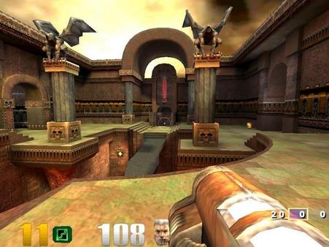
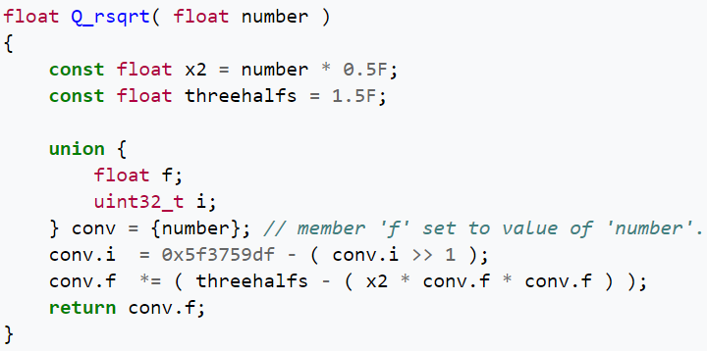
Graphic Processing – Some History
Before 3D accelerators (GPUs) were common
CPUs had to do all graphics computation, while maintaining framerate!
Many tricks were played
Quake III arena (1999) : “Fast inverse square root”
magic!

Slide 5
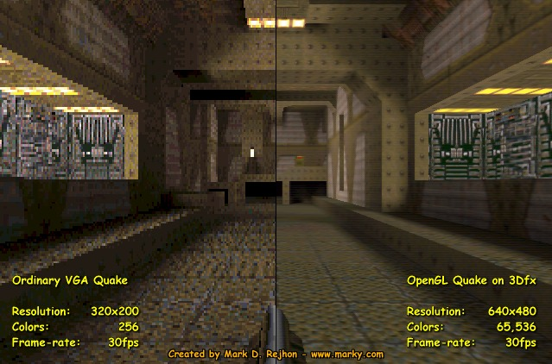
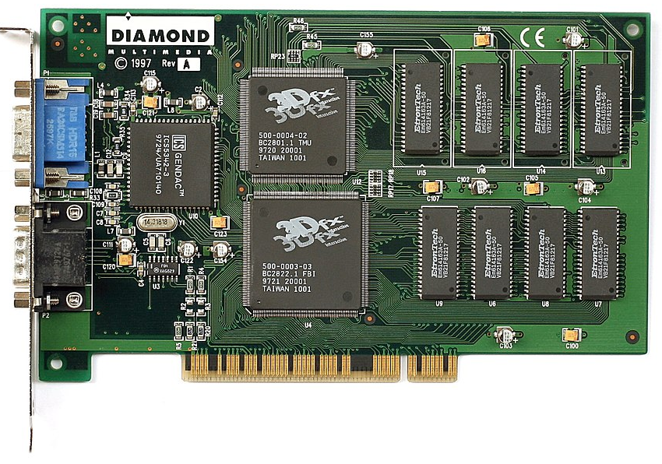
Introduction of 3D Accelerator Cards
Much of 3D processing is short algorithms repeated on a lot of data
pixels, polygons, textures, …
Dedicated accelerators with simple, massively parallel computation
A Diamond Monster 3D, using the Voodoo chipset (1997)
(Konstantin Lanzet, Wikipedia)

Slide 6
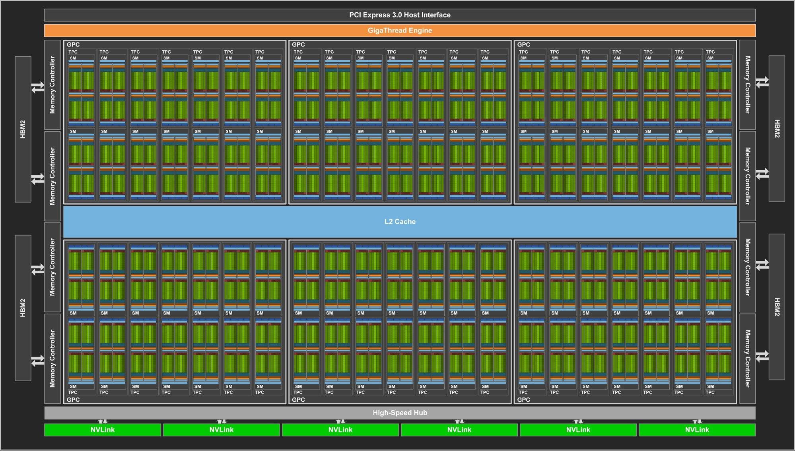
NVIDIA Volta-based GV100 Architecture (2018)
Many many cores,
not a lot of cache/control

Slide 7
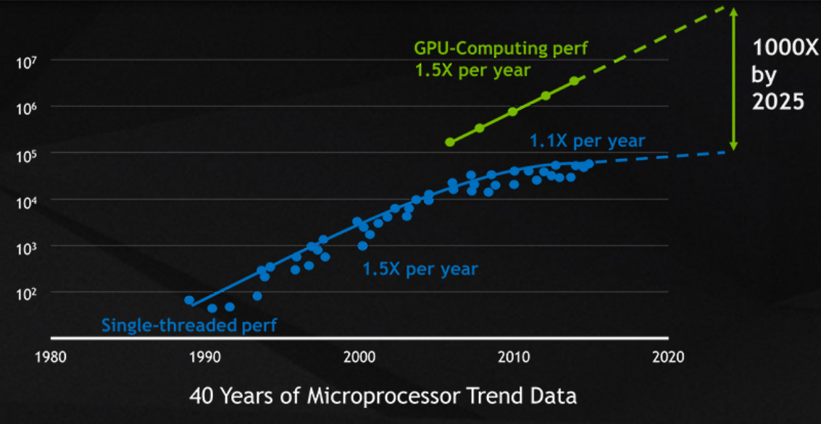

Peak Performance vs. CPU
 | Throughput | Power | Throughput/Power
Intel Skylake | 128 SP GFLOPS/4 Cores | 100+ Watts | ~1 GFLOPS/Watt
NVIDIA V100 | 15 TFLOPS | 200+ Watts | ~75 GFLOPS/Watt
Also,

Slide 8
System Architecture Snapshot With a GPU (2019)
GPU Memory
(GDDR5,
HBM2,…)
GPU
GDDR5: 100s GB/s, 10s of GB
HBM2: ~1 TB/s, 10s of GB
NVMe
CPU
I/O Hub (IOH)
DDR4 2666 MHz
128 GB/s
100s of GB
Network Interface
…
QPI/UPI
12.8 GB/s (QPI)
20.8 GB/s (UPI)
PCIe
16-lane PCIe Gen3: 16 GB/s
…
Host Memory
(DDR4,…)
Lots of moving parts!

Slide 9
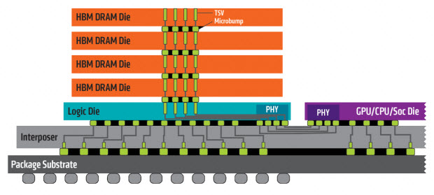
High-Performance Graphics Memory
Modern GPUs even employing 3D-stacked memory via silicon interposer
Very wide bus, very high bandwidth
e.g., HBM2 in Volta
Graphics Card Hub, “GDDR5 vs GDDR5X vs HBM vs HBM2 vs GDDR6 Memory Comparison,” 2019

Slide 10
Massively Parallel Architecture For Massively Parallel Workloads!
NVIDIA CUDA (Compute Uniform Device Architecture) – 2007
A way to run custom programs on the massively parallel architecture!
OpenCL specification released – 2008
Both platforms expose synchronous execution of a massive number of threads
GPU Threads
…
GPU
Thread
Copy over PCIe
Copy over PCIe
CPU

Slide 11
CUDA Execution Abstraction
Block: Multi-dimensional array of threads
1D, 2D, or 3D
Threads in a block can synchronize among themselves
Threads in a block can access shared memory
CUDA (Thread, Block) ~= OpenCL (Work item, Work group)
Grid: Multi-dimensional array of blocks
1D or 2D
Blocks in a grid can run in parallel, or sequentially
Kernel execution issued in grid units
Limited recursion (depth limit of 24 as of now)

Slide 12
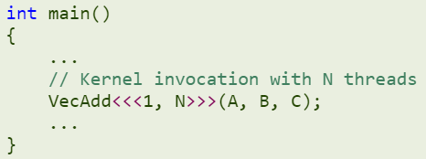
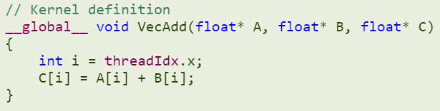
Simple CUDA Example
Asynchronous call
CPU side
GPU side
Host Compiler
C/C++
+ CUDA
Code
NVCC
Compiler
CPU+GPU
Software
Device Compiler

Slide 13
Simple CUDA Example
1 block
__global__: In GPU, called from host/GPU
__device__: In GPU, called from GPU
__host__: In host, called from host
N threads per block
Should wait for kernel to finish
N instances of VecAdd spawned in GPU
One function can be both
Which of N threads am I?
See also: blockIdx
Only void allowed

Slide 14
More Complex Example: Picture Blurring
Slides from NVIDIA/UIUC Accelerated Computing Teaching Kit
Another end-to-end example https://devblogs.nvidia.com/even-easier-introduction-cuda/
Great! Now we know how to use GPUs – Bye?

Slide 15
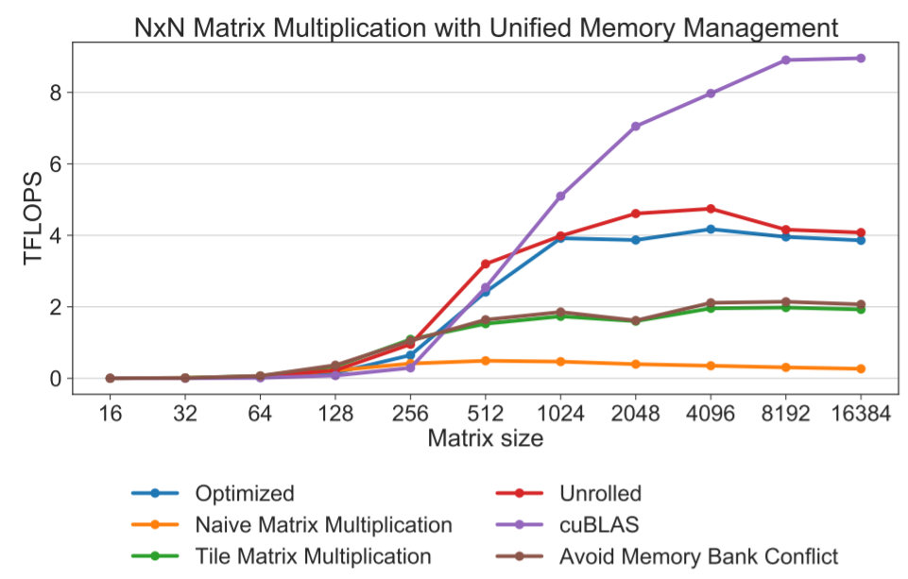
Matrix Multiplication Performance Engineering
No faster than CPU
Results from NVIDIA P100
Coleman et. al., “Efficient CUDA,” 2017
Architecture knowledge is needed (again)

Slide 16
NVIDIA Volta-based GV100 Architecture (2018)
Single Streaming Multiprocessor (SM) has
64 INT32 cores and 64 FP32 cores
(+8 Tensor cores…)
GV100 has 84 SMs

Slide 17
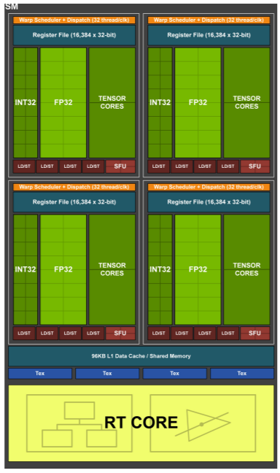
Volta Execution Architecture
64 INT32 Cores, 64 FP32 Cores, 4 Tensor Cores, Ray-tracing cores..
Specialization to make use of chip space…?
Not much on-chip memory per thread
96 KB Shared memory
1024 Registers per FP32 core
Hard limit on compute management
32 blocks AND 2048 threads AND 1024 threads/block
e.g., 2 blocks with 1024 threads, or 4 blocks with 512 threads
Enough registers/shared memory for all threads must be available (all context is resident during execution)
More threads than cores – Threads interleaved to hide memory latency

Slide 18
Resource Balancing Details
How many threads in a block?
Too small: 4x4 window == 16 threads
128 blocks to fill 2048 thread/SM
SM only supports 32 blocks -> only 512 threads used
SM has only 64 cores… does it matter? Sometimes!
Too large: 32x48 window == 1536 threads
Threads do not fit in a block!
Too large: 1024 threads using more than 64 registers
Limitations vary across platforms (Fermi, Pascal, Volta, …)

Slide 19
Warp Scheduling Unit
Threads in a block are executed in 32-thread “warp” unit
Not part of language specs, just architecture specifics
A warp is SIMD – Same PC, same instructions executed on every core
What happens when there is a conditional statement?
Prefix operations, or control divergence
More on this later!
Warps have been 32-threads so far, but may change in the future

Slide 20
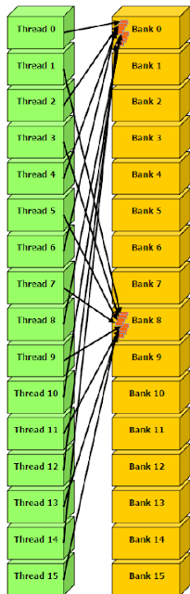
Memory Architecture Caveats
Shared memory peculiarities
Small amount (e.g., 96 KB/SM for Volta) shared across all threads
Organized into banks to distribute access
Bank conflicts can drastically lower performance
Relatively slow global memory
Blocking, caching becomes important (again)
If not for performance, for power consumption…
8-way bank conflict
1/8 memory bandwidth

